Slide 1
Past Projects
Ali Aqdas

Slide 2
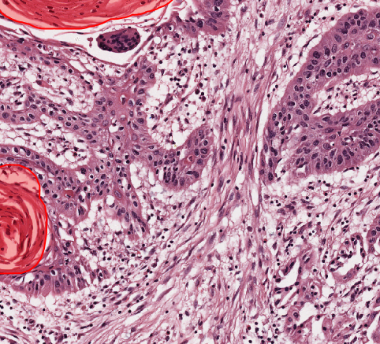
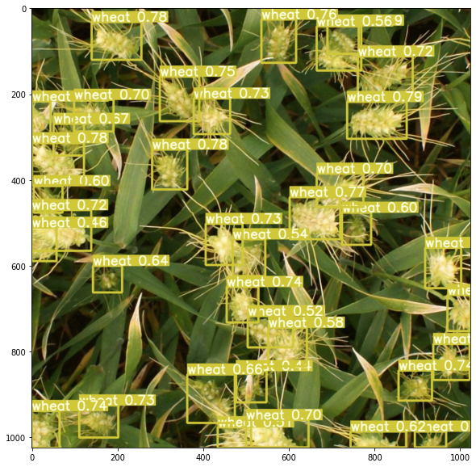
List of Projects
Keratin Pearls Binary Mask Image Segmentation
Dental Radiographs Image Segmentation
Epithelial Cells Binary Mask Image Segmentation
YOLOv5 Wheat Head Detection

Slide 3
Keratin Pearl Binary Image Segmentation

Slide 4

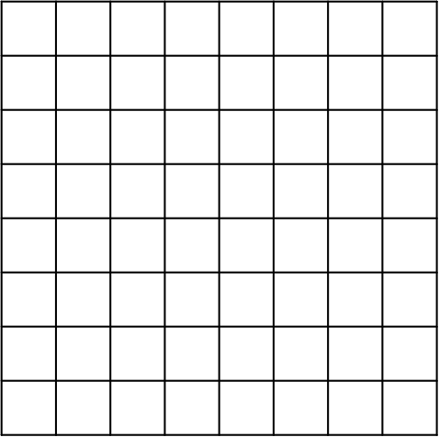
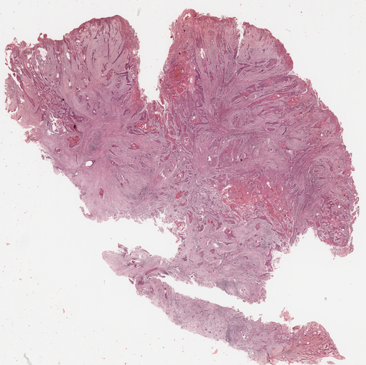
Tasks
Loading and Tiling of Whole Slide Image
Mask Generation
Training a Neural Network for Image Segmentation

Slide 5

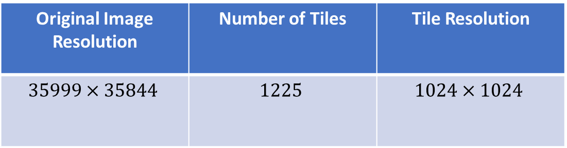
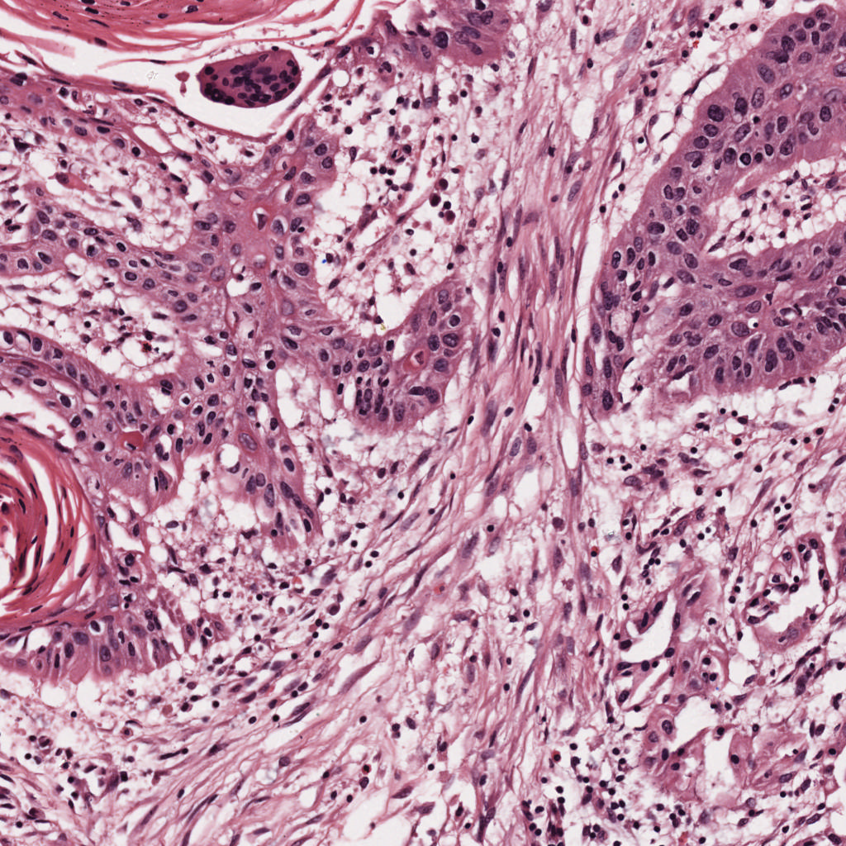
Loading and Tiling of Whole Slide Image
Loaded Whole Slide Images using OpenSlide
OpenSlide is a C-Library with Python Bindings
Slicing an ultra-high resolution image
into equally sized tiles
Original Image Resolution | Number of Tiles | Tile Resolution
$$35999×35844$$ | $$1225$$ | $$1024×1024$$

Slide 7
Generating a Binary Mask
Generated a GeoJSON Annotation file from QuPath
Developed a Code to read GeoJSON coordinates
Used SciKit-Image Framework to Generate Mask
QuPath Annotation
Generate Binary Mask

Slide 8
Training A U-Net Learner
Used Fast-AI Library
U-Net Architecture for Semantic Segmentation
Trained for 35 Epochs
Training Time on GPU is 5 Hours
FINAL EPOCH
Train Loss | Valid Loss | Dice | F-Beta
0.017748 | 0.011935 | 0.918644 | 0.012968

Slide 9
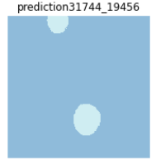
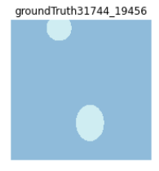
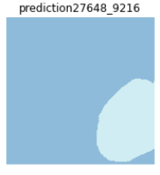
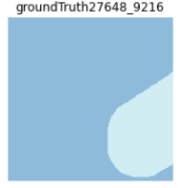
Training A U-Net Learner
Used Fast-AI Library
U-Net Architecture for Semantic Segmentation
Trained for 35 Epochs
Training Time on GPU is 5 Hours

Slide 10

Dental Radiographs Multi Class Segmentation

Slide 11
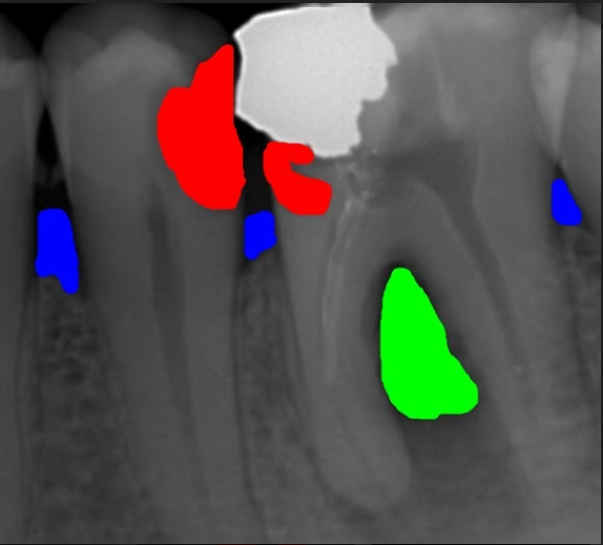
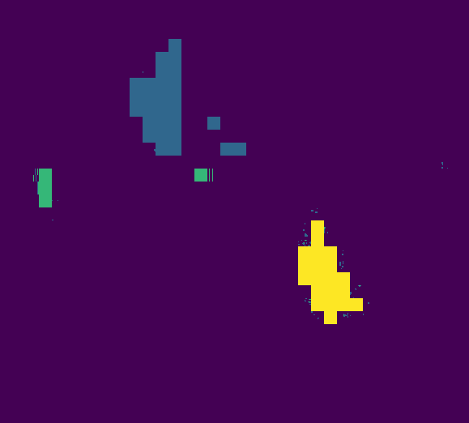
Tasks
Color Filtering and Background Removal of Masks
Multi Class Segmentation of Train Dataset

Slide 12
Results
Trained for 60 Epochs
Reasons for Poor Performance
Small Dataset
Low Quality Masks
Radiograph Images
FINAL EPOCH
Train Loss | Valid Loss | Dice | F-Beta
0.133 | 0.125 | 0.198 | 0.1065

Slide 13
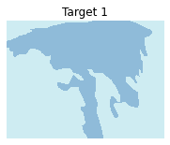
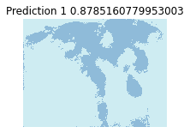
Epithelial Cells
Training of U-Net for Image Segmentation of Epithelial Cells
Following results were obtained
FINAL EPOCH
Train Loss | Valid Loss | Dice | F-Beta
0.291 | 0.22 | 0.859 | 0.5637

Slide 14
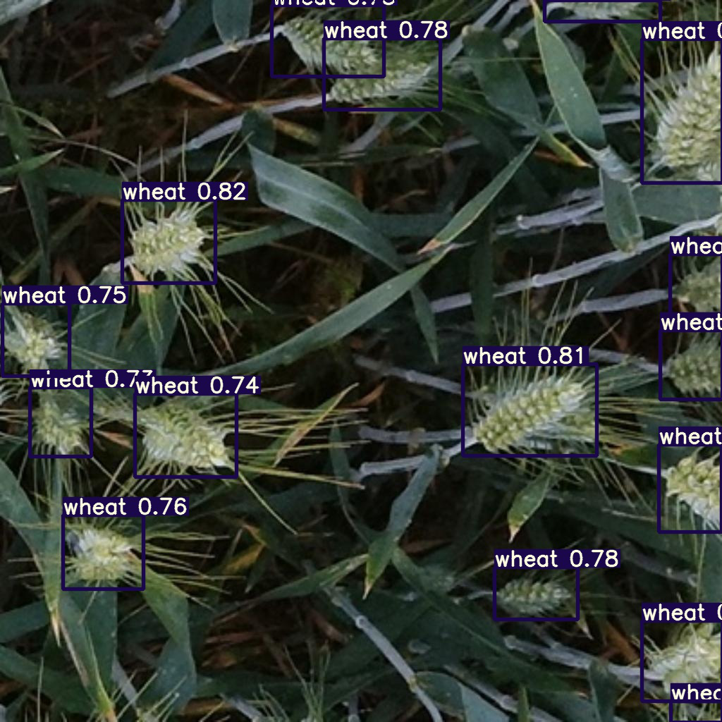
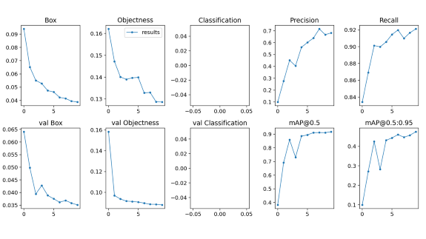
YOLOv5 Object Detection
Task Assigned to learn to object detection
Detected Wheat Heads using YOLOv5
Trained for 10 Epochs

Slide 15
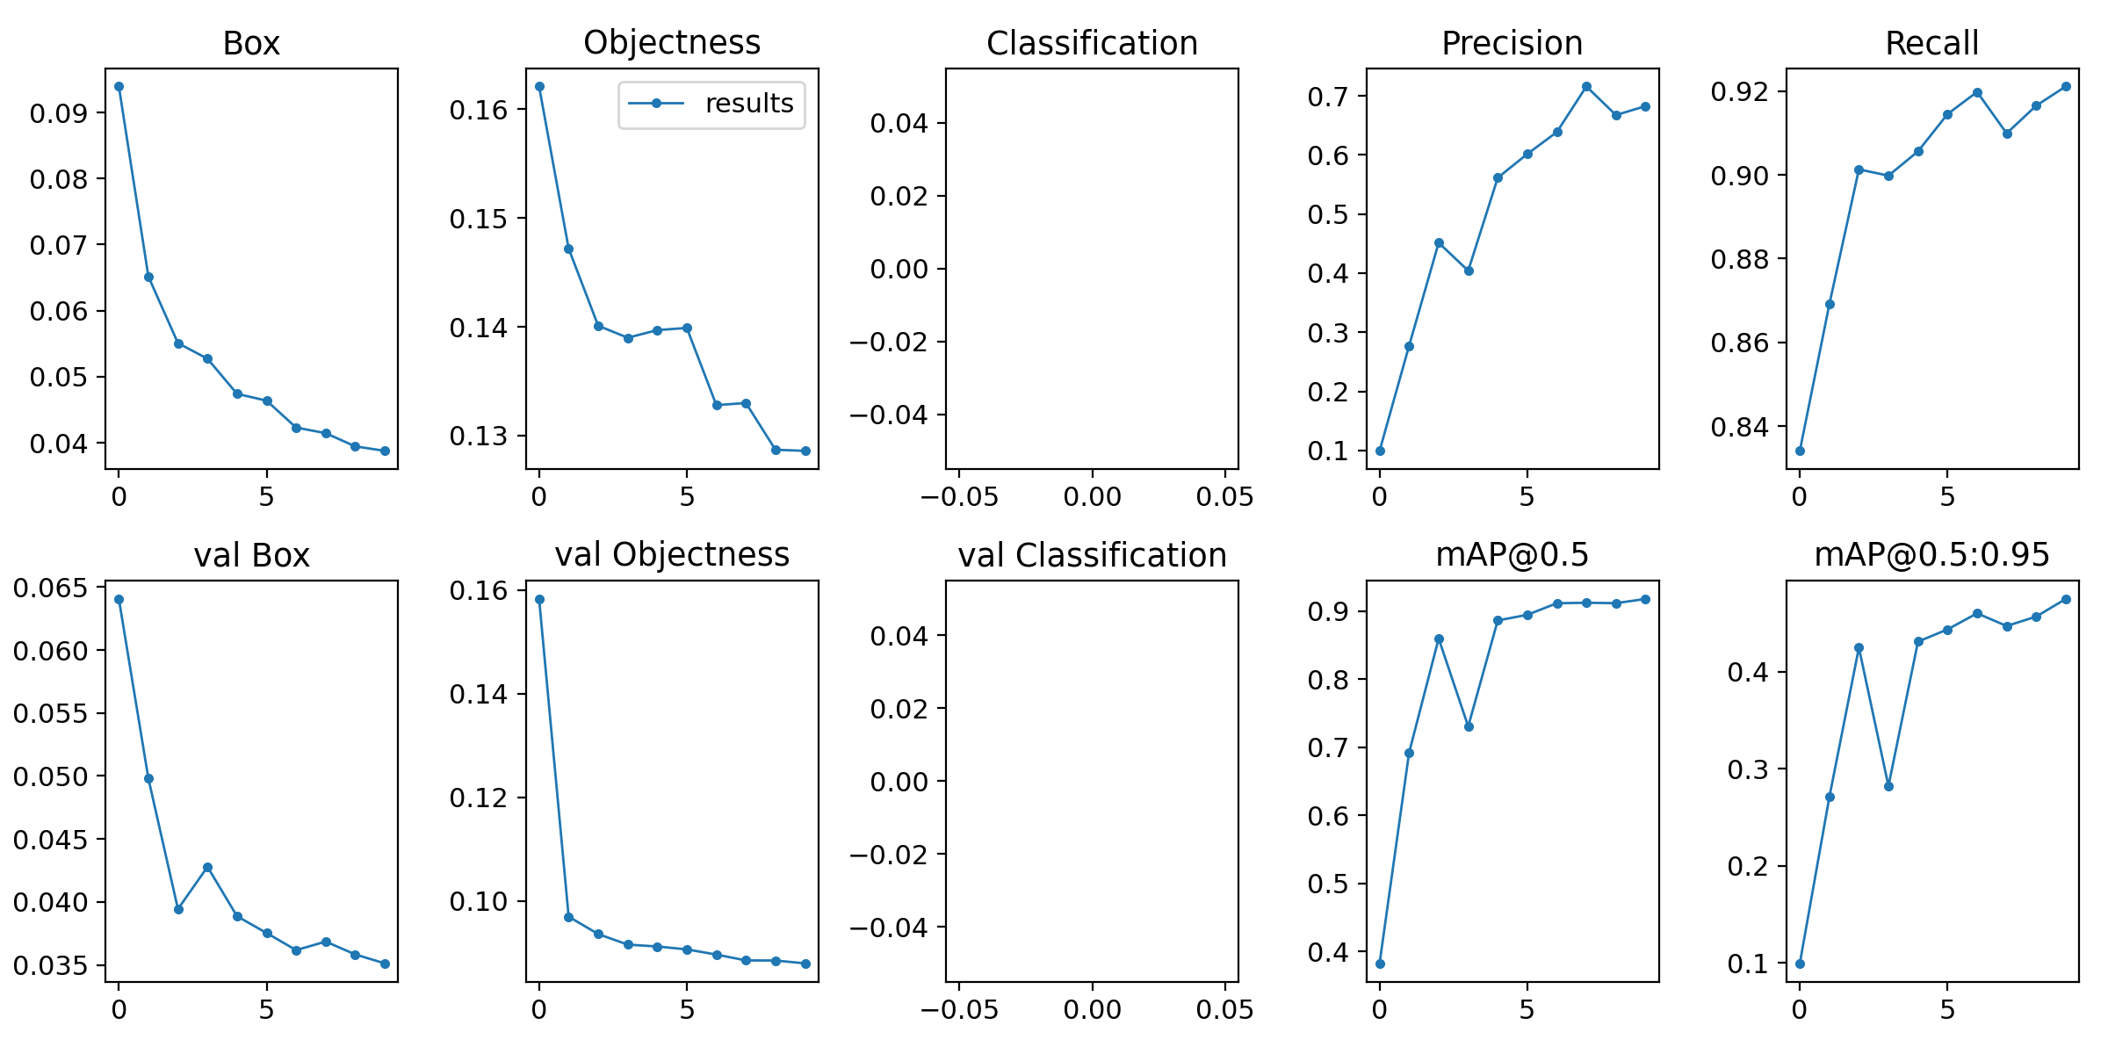

Slide 17


